Slide 1
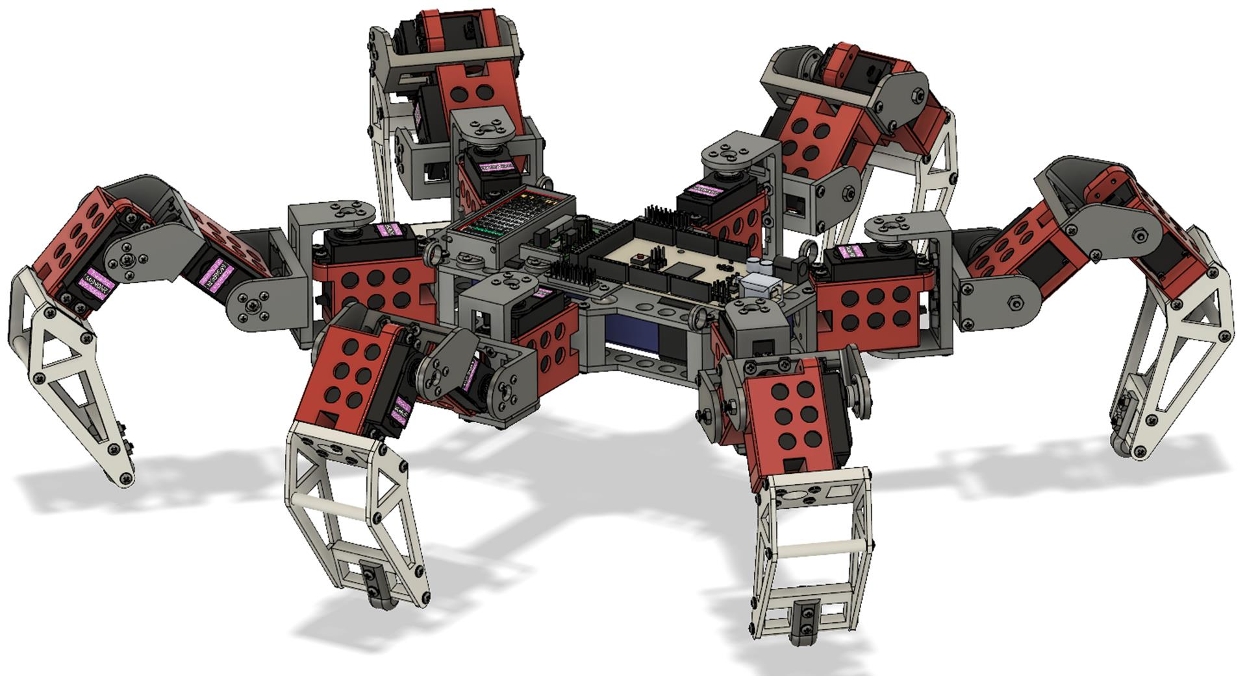
Hexapod Spider Robot
MSPY
Pankaj Kumar
Shivesh Pandey
Mukul Kumar
Harshul Aggarwal
Jasmeet Singh

Slide 2
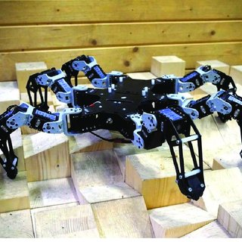
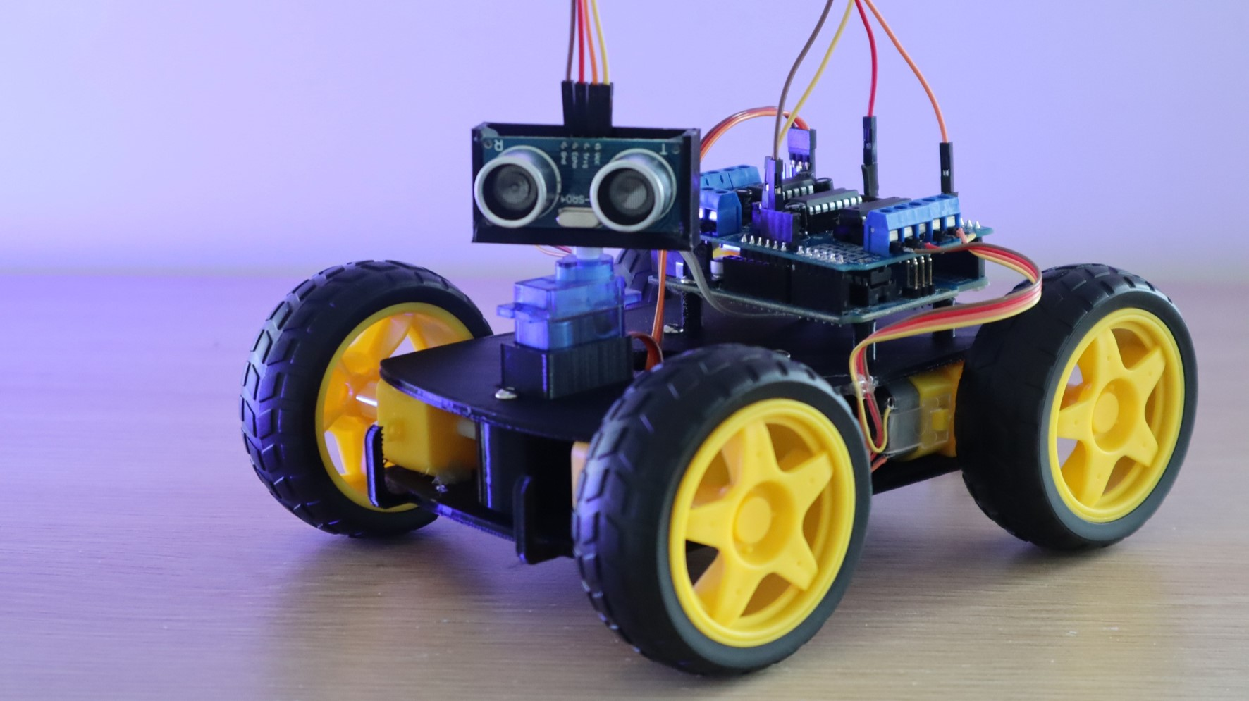
Why Use Spider Robot?
Spider Robots
Mini robots
They can go to different terrains.
Its difficult to go to different terrains

Slide 3
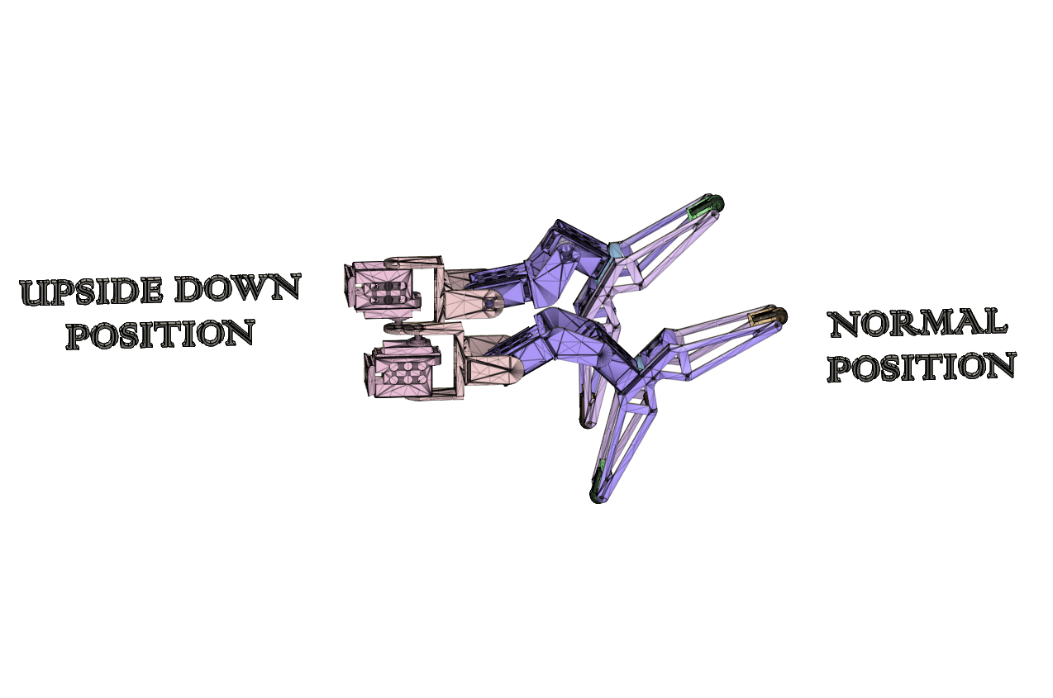
What If It Fall Upside Down!
It can walk Upside Down

Slide 4


Programming & Operating System

Slide 5

Security & Hackers
Low Risk Of Hackers

Slide 6

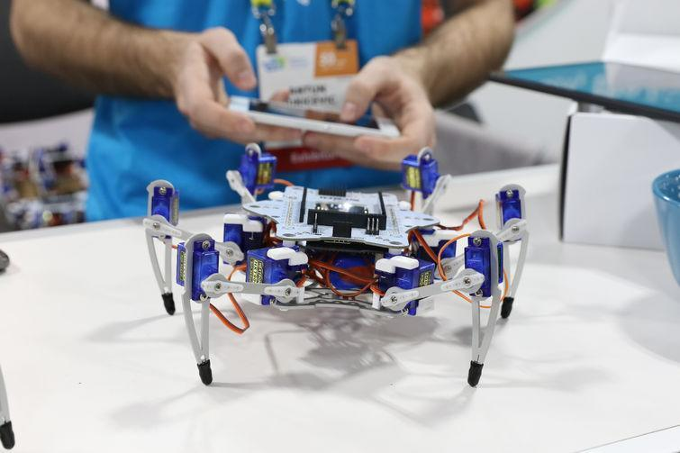
Where This Is Useful
Military
Spy
Robot

Slide 7
THANK YOU

